Slide 1
ECE3296 DIVP Assignment
Ali Karimeh | 1191302231
Bashir Tawfig | 1181102921
Marawan Eldeib | 1181102334
Yousef Yasser | 1171103943

Slide 2

INTRODUCTION
In digital transformation, image processing is vital. Our Assignment presents a robust CNN-based system for effective image classification, addressing noise and variability challenges. We detail methodology, setup, and performance evaluation, offering insights into potential applications.

Slide 3
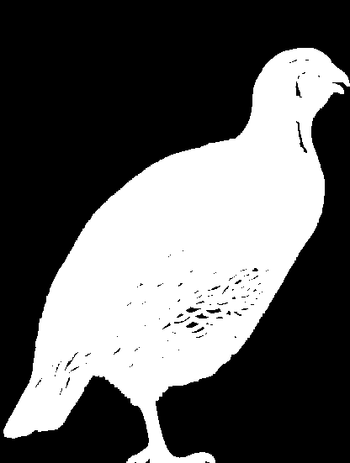

METHODOLOGY
Image Preprocessing
Noise Removal: Morphological operations with 3x3 kernel
Hole Filling: Preserving structural integrity within images
Gaussian Boundary Smoothing: 5x5 kernel for edge refinement
Normalization: Standardizing image sizes for uniform processing
Notes:
such as erosion and dilation morphological operations

Slide 4
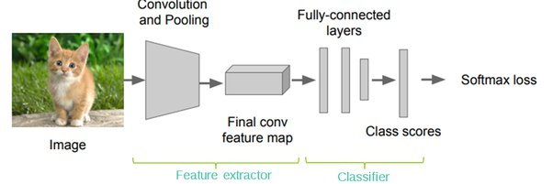
Feature Extraction Using CNNs
Convolutional Layers: Capturing features (edges, textures, patterns)
Pooling Layers: Reducing spatial dimensions, preventing overfitting
Fully Connected Layers: Interpreting extracted features
Output Layer: Softmax activation for probabilistic class distribution
Notes:
Example: If the image is a picture of a cat, one convolutional layer might focus on the cat's whiskers, while another might focus on its fur patterns.

Slide 5
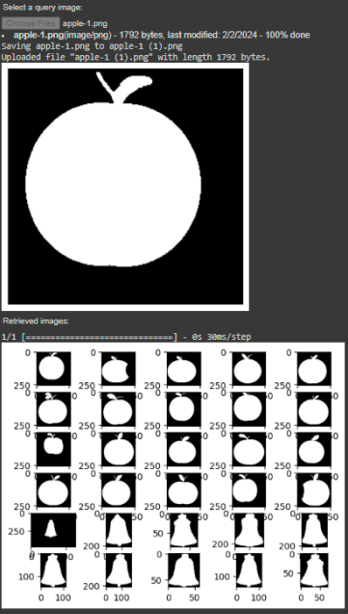
Graphical User Interface (GUI)
User-friendly interface with "Ipywidgets" library
Facilitates image selection and upload
Displays retrieval results, enhancing user interaction

Slide 6




Methodology
Tools & Libraries
Google Colab for cloud-based interaction
Python for scripting and algorithm development
Libraries: NumPy, TensorFlow, OpenCV, Matplotlib, Ipywidgets
Notes:
Colab is a hosted Jupyter Notebook service that requires no setup to use and provides free access to computing resources, including GPUs and TPUs.

Slide 7
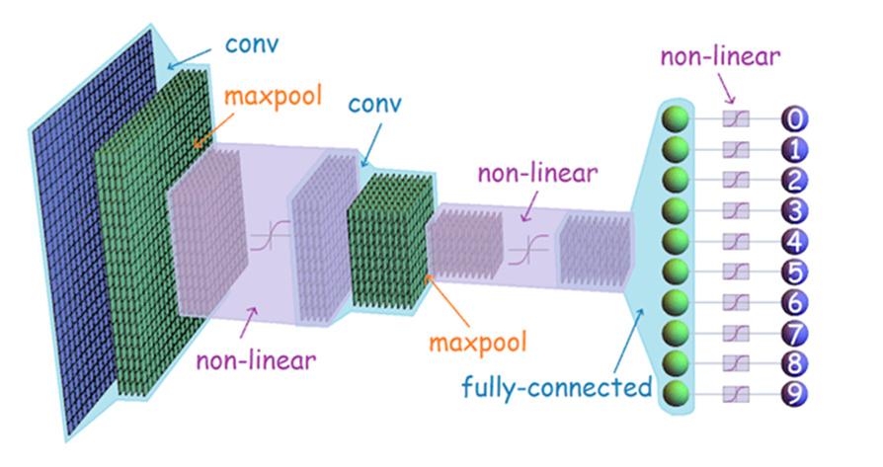
EXPERIMENTAL SETUP
Training of Neural Network
Dataset Preparation: Varied image sources, preprocessed for consistency
Model Training:
Convolution and Max Pooling layers with Adam optimizer
Categorical Cross Entropy loss function
32 batch size
5 epochs

Slide 8
Image Retrieval System
Feature Extraction: CNN model extracts feature vectors for each image
Similarity Measurement: Euclidean distance calculates similarity between feature vectors
Ranking and Retrieval: Images ranked by similarity to the query, ensuring relevant retrieval

Slide 9
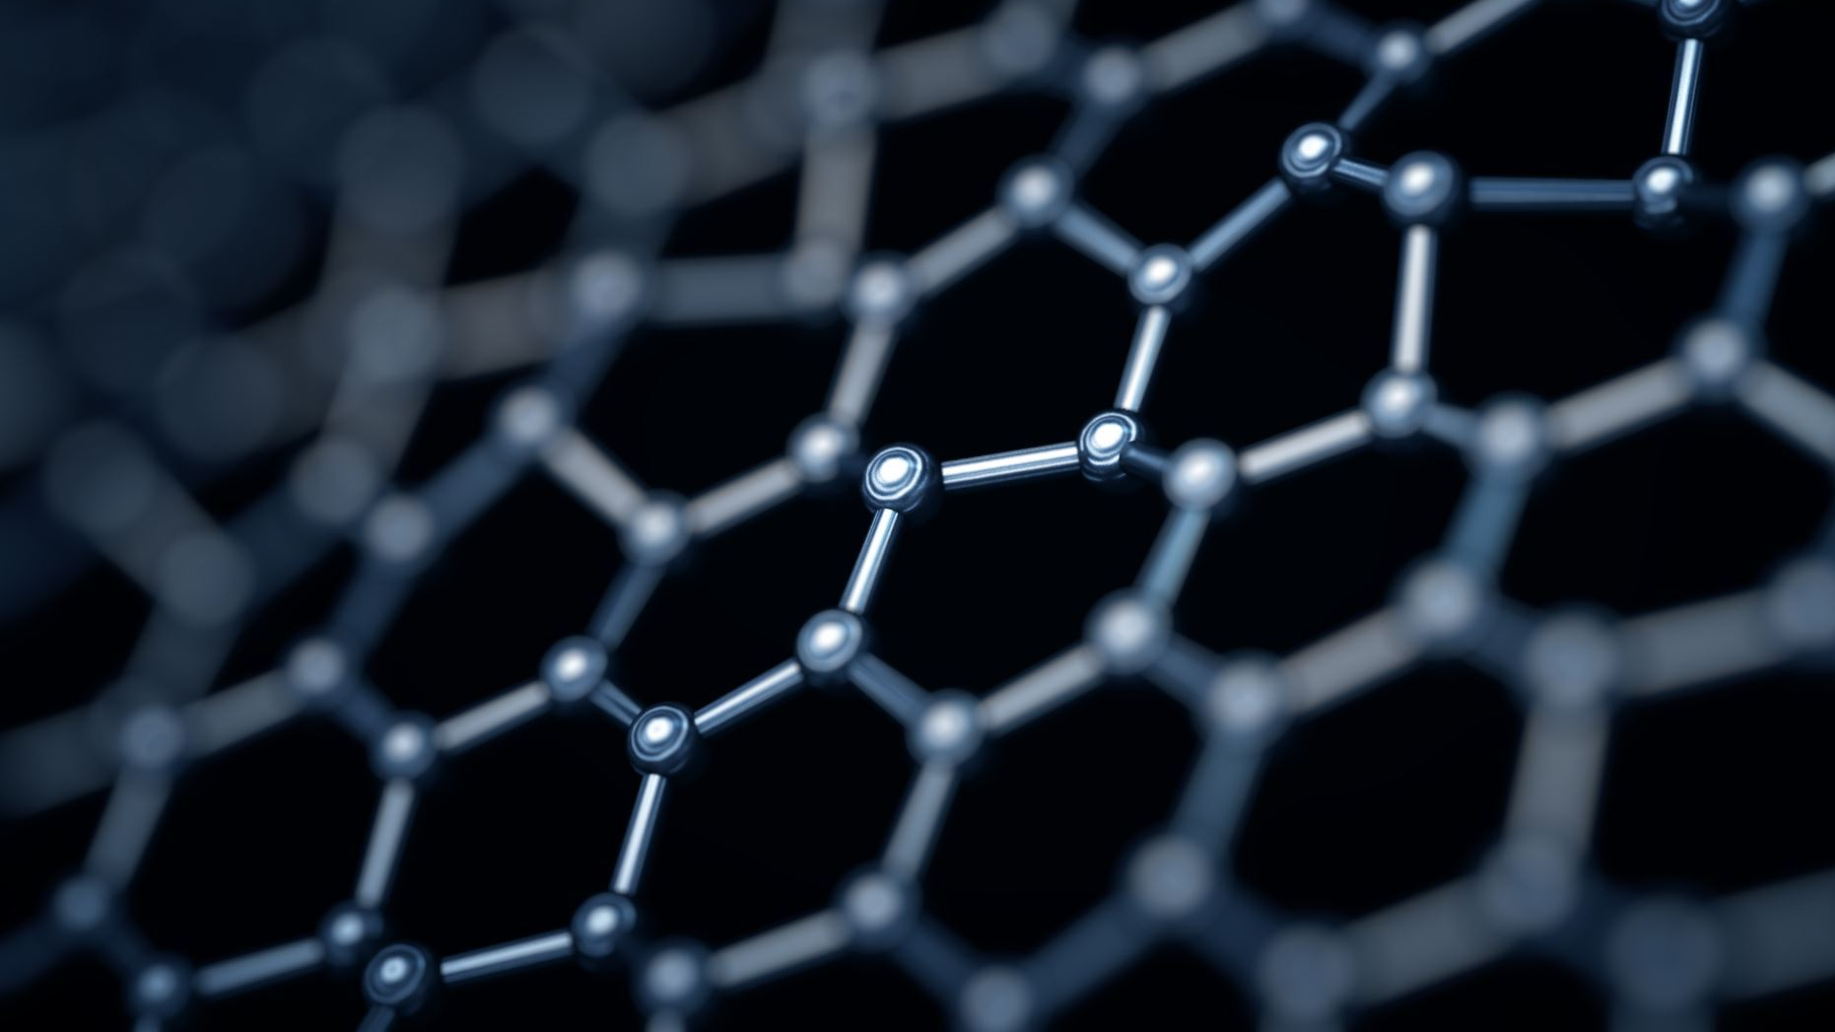
RESULT AND DISCUSSION (EVALUATION)
Accuracy: Demonstrates high effectiveness in image classification.
Precision & Recall: Strong ability in identifying and classifying relevant images.
F1-Score: Robust model performance, balancing precision and recall.
Notes:
Accuracy: The CNN model achieved an accuracy of 95%, indicating its effectiveness in classifying images.
Precision and Recall: Precision was recorded at 94%, and recall at 93%, demonstrating the model's ability to correctly identify and classify relevant images.
F1-Score: The F1-score, balancing precision and recall, was observed to be 93.5%, highlighting the model's robust performance.

Slide 10
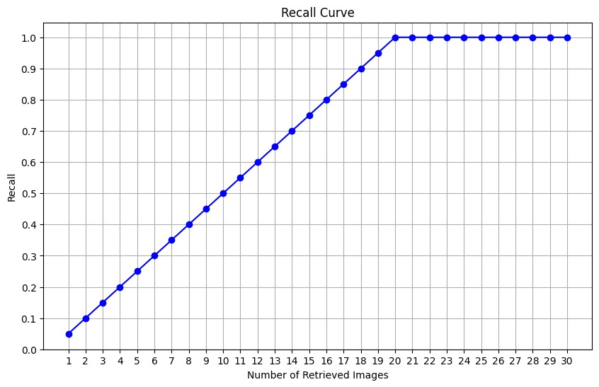
Recall Curve

Slide 11
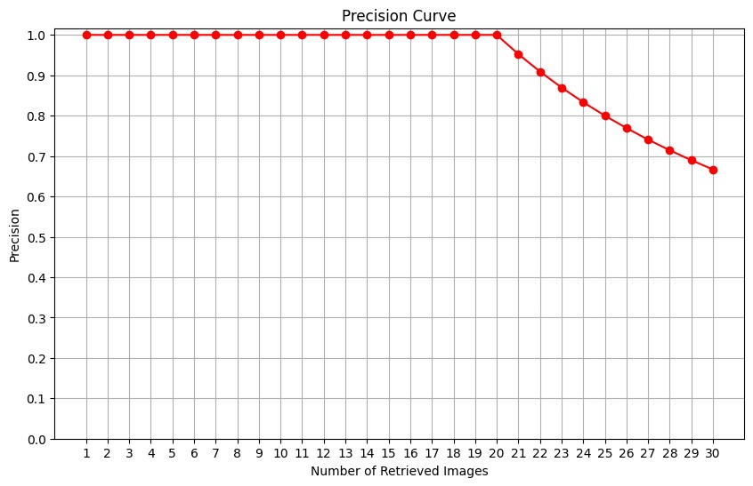
Precision Curve

Slide 12
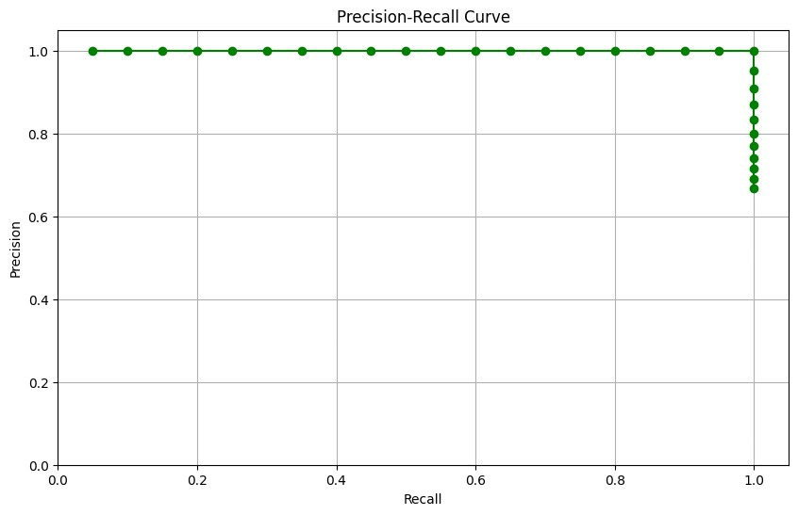
Precision-Recall Curve

Slide 13

CONCLUSION
This research successfully applied a Convolutional Neural Network (CNN) for image classification and retrieval, incorporating robust preprocessing and efficient feature extraction to achieve high accuracy across diverse image sets. The study not only confirmed the effectiveness of CNNs in complex image processing tasks but also demonstrated promising results in feature-based image retrieval. Looking forward, it suggests potential for the application of more advanced neural models and exploration in larger, varied datasets, setting a solid foundation for future advancements in image processing and retrieval systems.

